Slide 1

Chatterbox – Chat Application
ANMOL SAXENA & MEHUL JAIN (2YA-2022)
2022sp93061 2022sp93084
Present-
"Chatterbox - Your Thoughts, Our Playground, Infinite Conversational Adventures."

Slide 2
What is the project about
"Chatterbox" revolutionizes communication with Flutter, offering a seamless experience on iOS and Android.
Intuitive design, vibrant interface for user-friendliness. Flutter integration ensures consistent performance, enhancing the user experience.

Slide 3
Architecture of App
Client-Server Model:
Chatterbox follows a classic client-server architecture.
The client is the Flutter-based mobile app, and the server manages communication and data.
Firebase Cloud Messaging (FCM):
FCM is integrated for real-time push notifications.
Ensures users are promptly notified of new messages, even when the app is in the background.
Firestore Database:
Firestore, a NoSQL database, stores user profiles, chat messages, and other relevant data.
Provides a scalable and flexible data structure.
REST API:
RESTful APIs facilitate communication between the Flutter app and the server.
Handles actions like sending and receiving messages, retrieving chat history, and managing user profiles.
Firebase Authentication:
Firebase Authentication secures user logins and ensures only authorized users can access the app.
Enhances the overall security of the app.

Slide 4
Layer Diagram
Chat App
Application Logic (State Management, Business Logic)
External Services
(Other APIs, Databases, etc.)
Firebase Storage
(Media, File Storage)
Firebase Auth (Authentication)
Firebase Cloud
Messaging (FCM)
Firebase Realtime Database (Optional)
User Interface (Flutter)
Firestore
(NoSQL Database)

Slide 5
Architecture Diagram
Firebase Messaging Service
Firebase authentication
Flutter App
Firebase Cloud Functions
Firebase storage module

Slide 6

Design
Responsive UI: Flutter ensures a consistent and responsive user interface.
Real-Time Updates: FCM and Firestore enable real-time updates for instant message delivery.
User Authentication: Firebase Authentication secures user accounts and access.
Data Security: Firebase services provide built-in security features, including encryption and secure connections.

Slide 7
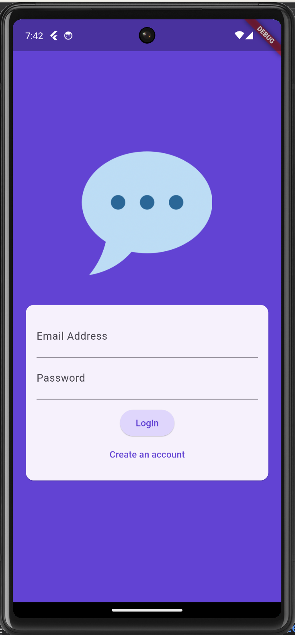
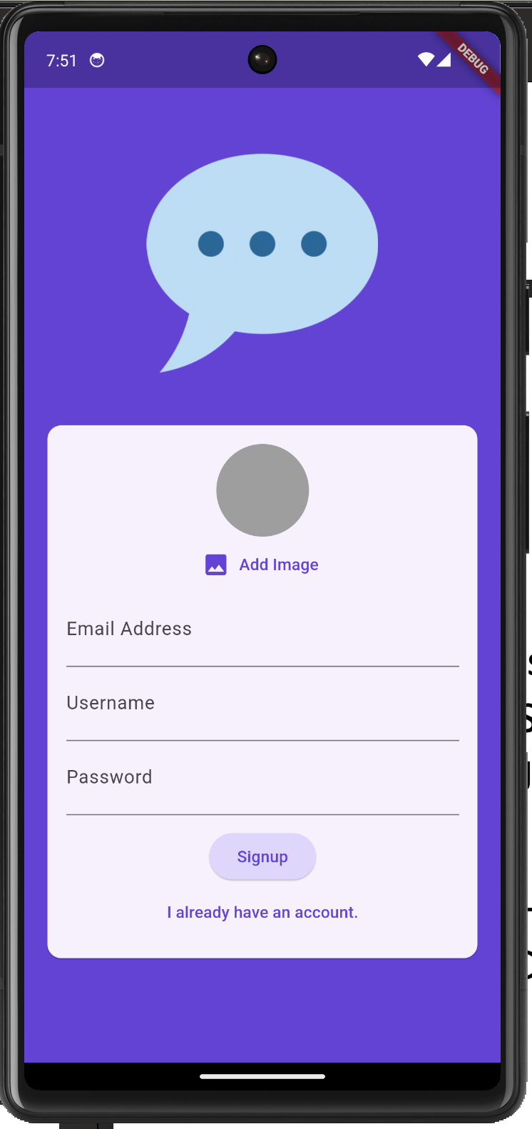
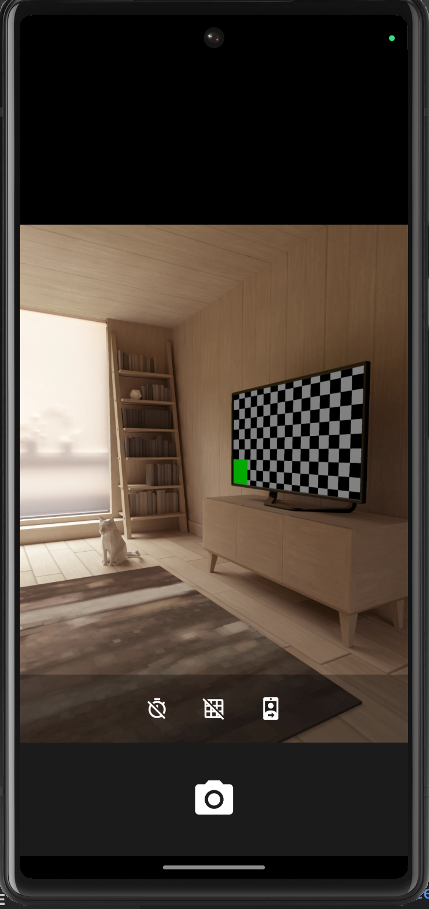
Screenshots
Login Screen
Signup Screen
Add Profile Image

Slide 8
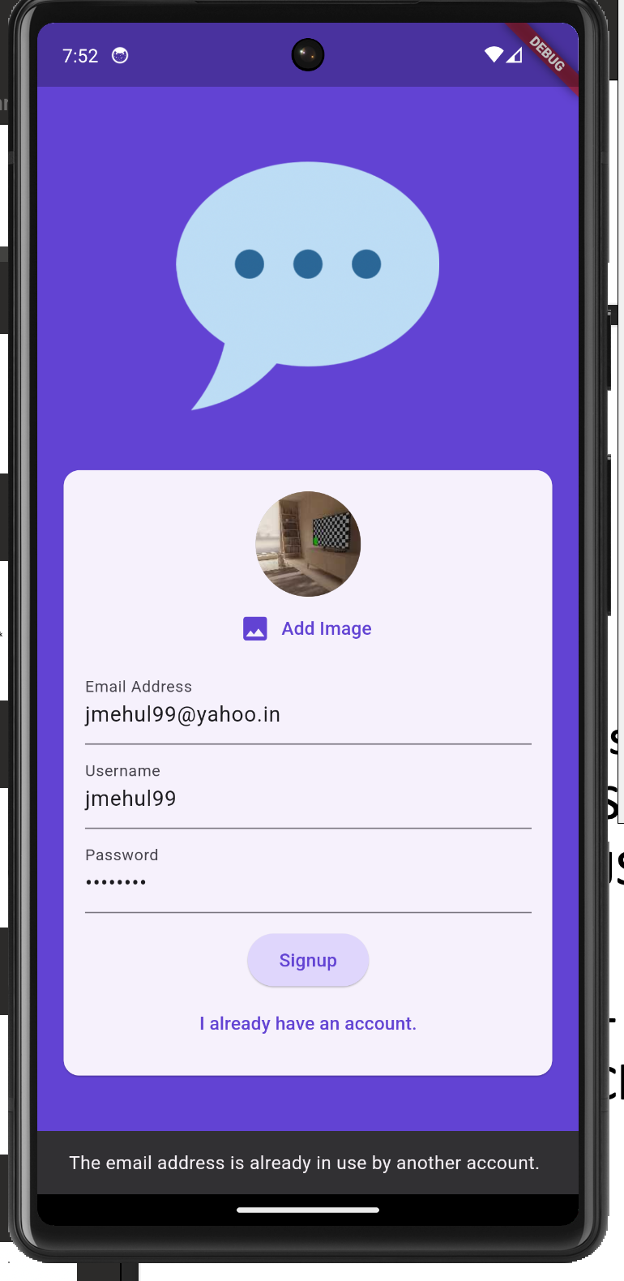
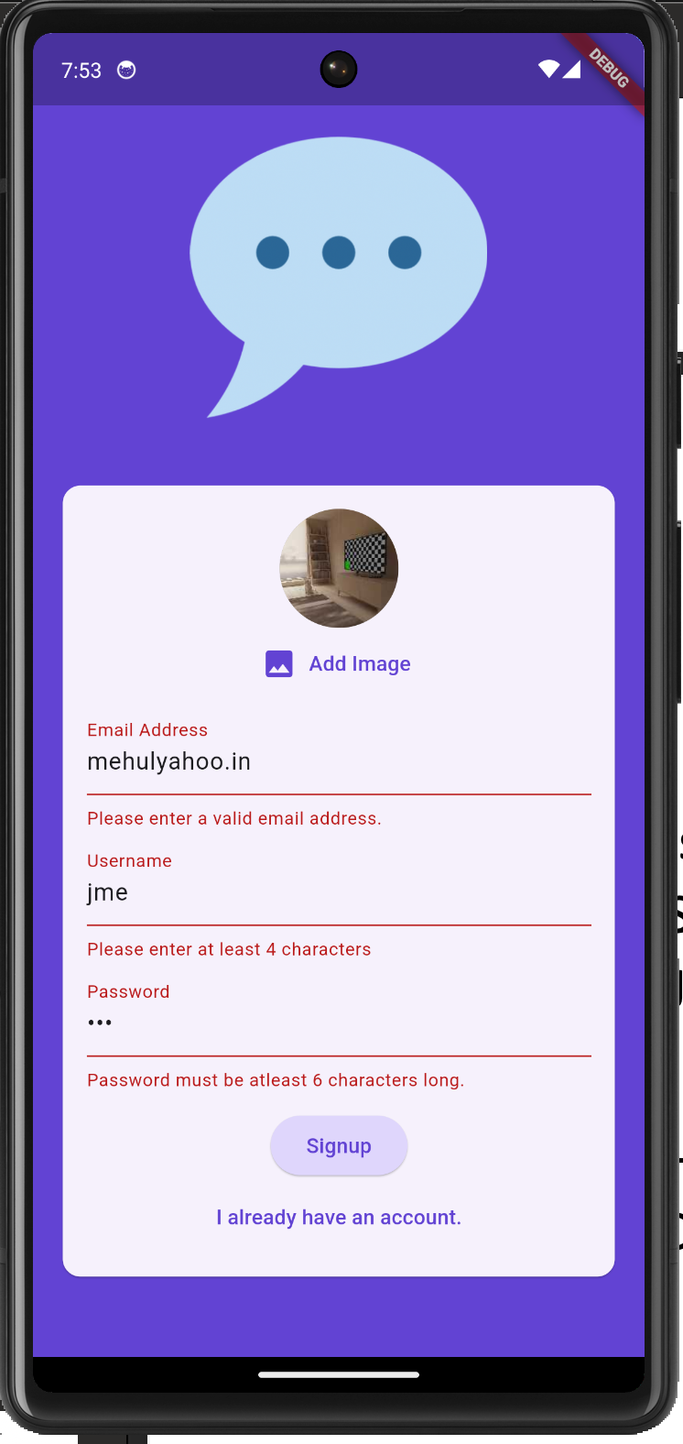
Screenshots
Email Already Exists
Field Validation

Slide 9
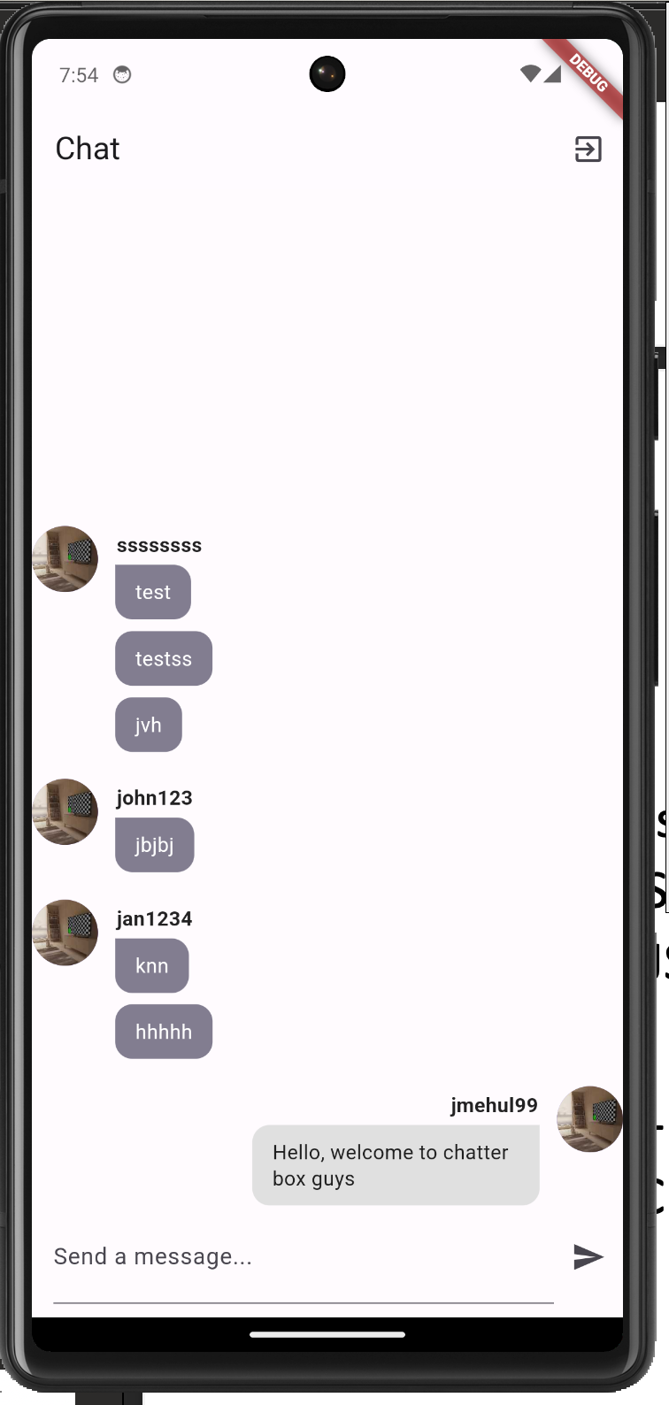
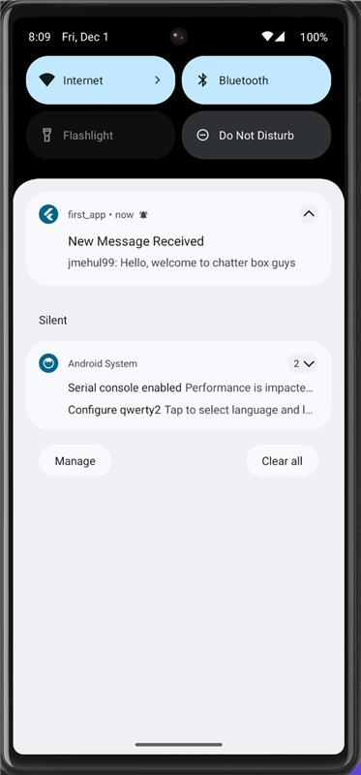
Screenshots
Chat Window
Push Notification

Slide 10
Challenging or Interesting parts of Project
Cross-Platform Compatibility:
Challenge: Ensuring consistent functionality and performance across both iOS and Android platforms.
Solution: Leverage Flutter's cross-platform capabilities, conduct thorough testing on both platforms, and address any platform-specific nuances or issues.
User Authentication and Security:
Challenge: Ensuring secure user authentication, handling login/logout scenarios, and maintaining data security.
Solution: Implement Firebase Authentication with robust error handling, consider two-factor authentication, and follow best practices for securing user data.

Slide 11
Challenging or Interesting parts of Project
Media Handling:
Challenge: Managing and displaying media files for profile picture, such as images.
Solution: Integrate Firebase Storage for media uploads and downloads. Implement efficient handling and display of various media types.
Real-Time Communication:
Challenge: Implementing real-time updates for messages and user presence can be complex.
Solution: Utilize Firebase's real-time capabilities, but carefully manage synchronization and optimize for efficient real-time communication.

